Slide 1
Measurement of Individual Delays Between Each Output
We have measured the delay between each output signal

Slide 2
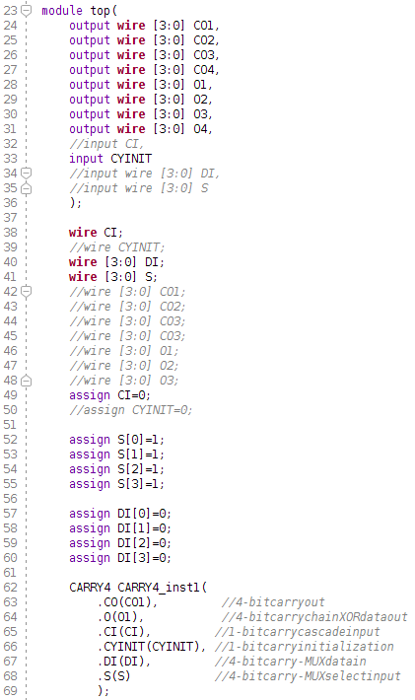
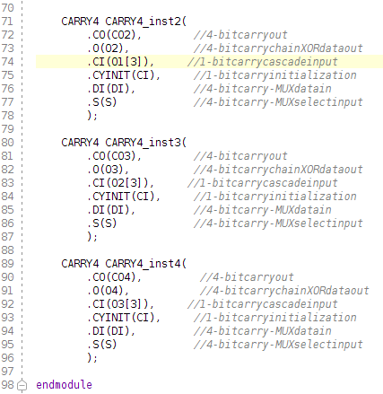
Our code-

Slide 3
Post-Synthesis timing simulation-
For the O output pin of all the carry4 primitives the output is received in the following order-
O1[0],O1[1],O1[2],O1[3],O2[0],O2[1],O2[2],O2[3],O3[0],O3[1],O3[2],O3[3],O4[0],O4[1],O4[2],O4[3]

Slide 4
Post-Implementation timing simulation-
Delay between |  | Delay
Input Signal | O1[0] | 4853 ps
O1[0] | O1[1] | 1 ps
O1[1] | O1[2] | 5 ps
O1[2] | O1[3] | 4 ps
O1[3] | O2[0] | 181 ps
O2[0] | O2[1] | 1 ps
O2[1] | O2[2] | 5 ps
O2[2] | O2[3] | 4 ps
O2[3] | O3[0] | 82 ps

Slide 5
Delay between |  | Delay
O3[0] | O3[1] | 1 ps
O3[1] | O3[2] | 5 ps
O3[2] | O3[3] | 4 ps
O3[3] | O4[0] | 82 ps
O4[0] | O4[1] | 1 ps
O4[1] | O4[2] | 5 ps
O4[2] | O5[3] | 4 ps

Slide 6
Post-Implementation timing simulation-
For the O output pin of all the carry4 primitives the output is received in the following order-
O1[0],O1[1],O1[2],O1[3],O2[0],O2[2],O2[3],O2[1],O3[0],O3[1],O3[2],O4[2],O4[0],O3[3],O4[1],O4[3]

Slide 7
Post-Implementation timing simulation-
Delay between |  | Delay
Input Signal | O1[0] | 5888 ps
O1[0] | O1[1] | 94 ps
O1[1] | O1[2] | 101 ps
O1[2] | O1[3] | 34 ps
O1[3] | O2[0] | 82 ps
O2[0] | O2[2] | 20 ps
O2[2] | O2[3] | 81 ps
O2[3] | O2[1] | 29 ps
O2[1] | O3[0] | 79 ps

Slide 8
Delay between |  | Delay
O3[0] | O3[1] | 20 ps
O3[1] | O3[2] | 106 ps
O3[2] | O4[2] | 13 ps
O4[2] | O4[0] | 13 ps
O4[0] | O3[3] | 20 ps
O3[3] | O4[1] | 73 ps
O4[2] | O4[3] | 9 ps

